Slide 1
Today’s Class
6:00PM – 7:45PM: Leveraging the Tidyverse to Simplify Data Wrangling
8:00PM – 9:00PM: Joining data (Not with SQL! In R!)
9:00PM – 9:50PM: Work on your mid-term, the session 4 in-class coding exercise.

Slide 2





This hour: Wrangling with the tidyverse
Intro: Logicals and Tibbles | 1: Strings | 2: Factors | 3: Dates/Times

Slide 3
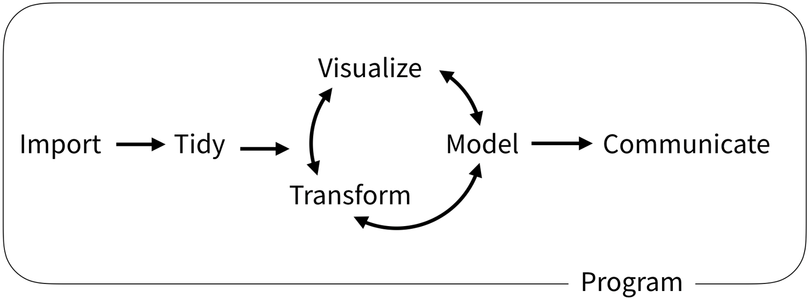
HOW THIS IMPROVES DATA SCIENCE PROJECTS

Slide 4

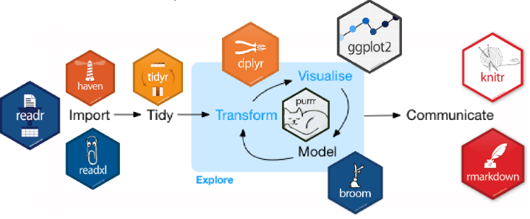
What Is the Tidyverse?
An opinionated collection of packages…
designed to simplify data analysis.

Slide 5

prerequisites

Slide 6
package prerequisite
library(tidyverse) # core tidyverse includes dplyr, stringr, and forcats
# may need to install the following packages first
library(lubridate)
library(glue)

Slide 7
data prerequisite
# go ahead and set your working directory to this week’s folder you downloaded
crime <- read_csv("cincinnati_crimes_20190812.csv")

Slide 8

Intro: Logicals

Slide 9
CREATING BOOLEAN VALUES
Operator | Description
> | a > b
>= | a >= b
< | a< b
<= | a <= b
== (check for equality) | a == b
!= (check for not equal) | a != b
%in% (check for group membership) | a %in% c(a, b, c)
is.na() | is.na(tailnum)
!is.na() | !is.na(tailnum)
# comparison operators create Boolean values
# i.e., TRUE and FALSE
# create Boolean values
2 <= 3
## [1] TRUE
# create a Boolean vector
!is.na(letters[1:15])
## [1] TRUE TRUE TRUE TRUE TRUE TRUE TRUE TRUE TRUE
## [10] TRUE TRUE TRUE TRUE TRUE TRUE

Slide 10
Logical values and data types
R’s data type for Boolean values
Creating a logical variable (vector) in your data set
# values can be logical
typeof(TRUE)
## [1] “logical”
typeof(FALSE)
## [1] “logical”
## vectors can be logical
x <- c(TRUE, NA, FALSE)
typeof(x)
## [1] “logical”
# generation z
crime %>%
select(INCIDENT_NO, SUSPECT_AGE) %>%
mutate(gen_z = SUSPECT_AGE %in% c("UNDER 18", "18-25"))
# A tibble: 21,153 x 3
INCIDENT_NO SUSPECT_AGE gen_z
<chr> <chr> <lgl>
1 199003291 26-30 FALSE
2 199006697 UNKNOWN FALSE
3 199002974 18-25 TRUE
4 199002942 UNKNOWN FALSE
5 199003557 UNKNOWN FALSE
6 199001482 UNKNOWN FALSE
7 199005210 31-40 FALSE
8 199006079 UNKNOWN FALSE
9 199006287 26-30 FALSE
10 199000792 UNKNOWN FALSE
# ... with 21,143 more rows

Slide 11
GENERATING INSIGHTS FROM LOGICALS
Count TRUEs by summing a logical vector
Find proportion of TRUEs by taking the mean of a logical vector
# quick example
x <- c(8, 4, 5, 1)
x
## [1] TRUE TRUE TRUE FALSE
# How many elements
# satisfy the condition?
sum(x)
## [1] 3
# generation z
crime %>%
select(INCIDENT_NO, SUSPECT_AGE) %>%
mutate(gen_z = SUSPECT_AGE %in% c("UNDER 18", "18-25")) %>%
summarize(pct_gen_z = mean(gen_z, na.rm = TRUE))
# A tibble: 1 x 1
pct_gen_z
<dbl>
1 0.176

Slide 12
Your turn!
Using our crimes data set:
After grouping by the DAYOFWEEK variable,
How many records occurred in the SNA_NEIGHBORHOOD of Clifton?
What percentage is this for each group?
BONUS! Can you calculate the counts and percentages without a mutate statement?

Slide 13
Solution
crime %>%
group_by(DAYOFWEEK) %>%
mutate(clifton = SNA_NEIGHBORHOOD == "CLIFTON") %>%
summarize(
num_clifton = sum(clifton, na.rm = TRUE),
num_total = n(),
pct_clifton = mean(clifton, na.rm = TRUE)
)
# A tibble: 8 x 4
DAYOFWEEK num_clifton num_total pct_clifton
<chr> <int> <int> <dbl>
1 FRIDAY 72 3062 0.0235
2 MONDAY 53 3020 0.0175
3 SATURDAY 34 2925 0.0116
4 SUNDAY 39 2883 0.0135
5 THURSDAY 30 2925 0.0103
6 TUESDAY 57 3048 0.0187
7 WEDNESDAY 46 2927 0.0157
8 NA 26 363 0.0716

Slide 14

Solution with bonus
crime %>%
group_by(DAYOFWEEK) %>%
summarize(
num_clifton = sum(SNA_NEIGHBORHOOD == "CLIFTON", na.rm = TRUE),
num_total = n(),
pct_clifton = mean(SNA_NEIGHBORHOOD == "CLIFTON", na.rm = TRUE)
)

Slide 15

Intro: TIBBLES

Slide 16
TIBBLES ARE UBIQUITOUS!
You’ve worked with tibbles before!
crime %>%
group_by(DAYOFWEEK) %>%
mutate(clifton = SNA_NEIGHBORHOOD == "CLIFTON") %>%
summarize(
num_clifton = sum(clifton, na.rm = TRUE),
num_total = n(),
pct_clifton = mean(clifton, na.rm = TRUE)
)
# A tibble: 8 x 4
DAYOFWEEK num_clifton num_total pct_clifton
<chr> <int> <int> <dbl>
1 FRIDAY 72 3062 0.0235
2 MONDAY 53 3020 0.0175
3 SATURDAY 34 2925 0.0116
4 SUNDAY 39 2883 0.0135
5 THURSDAY 30 2925 0.0103
6 TUESDAY 57 3048 0.0187
7 WEDNESDAY 46 2927 0.0157
8 NA 26 363 0.0716

Slide 17
What are tibbles?
From the Tidyverse website:
“A tibble, or tbl_df, is a modern reimagining of the data.frame, keeping what time has proven to be effective, and throwing out what is not.
Tibbles:
Are data frames, but with edited behaviors
Never change input data types (e.g., strings to factors, characters to numeric)
Never change variable names
Never create row names
Never gonna give you up
Allow non-syntactic variable names
crime %>%
head(10)
# A tibble: 10 x 40
INSTANCEID INCIDENT_NO DATE_REPORTED DATE_FROM DATE_TO CLSD UCR DST BEAT
<chr> <chr> <chr> <chr> <chr> <chr> <dbl> <chr> <chr>
1 92A296AB-~ 199003291 2/16/2019 10~ 2/16/201~ 2/16/2~ J--C~ 201 4 5
2 44ACB102-~ 199006697 4/4/2019 16:~ 4/4/2019~ 4/4/20~ Z--E~ 1151 2 1
3 2CED4B80-~ 199002974 2/12/2019 17~ 2/5/2019~ 2/7/20~ D--V~ 201 4 4
4 EEB41765-~ 199002942 2/12/2019 10~ 2/6/2019~ 2/6/20~ J--C~ 201 5 2
5 F4622DF5-~ 199003557 2/20/2019 15~ 2/19/201~ 2/19/2~ J--C~ 600 4 3
6 EF456ED0-~ 199001482 1/21/2019 11~ 1/20/201~ 1/21/2~ Z--E~ 600 4 2
7 0859E5C0-~ 199005210 3/15/2019 14~ 3/12/201~ 3/12/2~ H--W~ 1493 2 2
8 9B091265-~ 199006079 3/27/2019 4:~ 3/27/201~ 3/27/2~ Z--E~ 1400 1 3
9 D2DAF74C-~ 199006287 3/29/2019 15~ 3/29/201~ 3/29/2~ Z--E~ 600 4 2
10 43EEB437-~ 199000792 1/10/2019 13~ 1/9/2019~ 1/9/20~ J--C~ 600 5 1
# ... with 31 more variables: OFFENSE <chr>, LOCATION <chr>, THEFT_CODE <chr>,

Slide 18
CREATING TIBBLES
Create or coerce into tibble with as_tibble()
Create tibbles from individual vectors (recycling occurs)
as_tibble(iris)
# A tibble: 150 x 5
Sepal.Length Sepal.Width Petal.Length Petal.Width Species
<dbl> <dbl> <dbl> <dbl> <fct>
1 5.1 3.5 1.4 0.2 setosa
2 4.9 3 1.4 0.2 setosa
3 4.7 3.2 1.3 0.2 setosa
4 4.6 3.1 1.5 0.2 setosa
5 5 3.6 1.4 0.2 setosa
6 5.4 3.9 1.7 0.4 setosa
7 4.6 3.4 1.4 0.3 setosa
8 5 3.4 1.5 0.2 setosa
9 4.4 2.9 1.4 0.2 setosa
10 4.9 3.1 1.5 0.1 setosa
# ... with 140 more rows
tibble(
division = c("Columbus",
"Nashville",
"Atlanta"),
test_group = 1,
# use backticks for non-syntactical name
`:)_order` = 1:3
)
# A tibble: 3 x 3
division test_group `:)_order`
<chr> <dbl> <int>
1 Columbus 1 1
2 Nashville 1 2
3 Atlanta 1 3

Slide 19
DIFFERENCES BETWEEN TIBBLES AND DATA FRAMES: PRINT METHOD
Tibbles ☺
Base R ☹
as_tibble(iris)
# A tibble: 150 x 5
Sepal.Length Sepal.Width Petal.Length Petal.Width Species
<dbl> <dbl> <dbl> <dbl> <fct>
1 5.1 3.5 1.4 0.2 setosa
2 4.9 3 1.4 0.2 setosa
3 4.7 3.2 1.3 0.2 setosa
4 4.6 3.1 1.5 0.2 setosa
5 5 3.6 1.4 0.2 setosa
6 5.4 3.9 1.7 0.4 setosa
7 4.6 3.4 1.4 0.3 setosa
8 5 3.4 1.5 0.2 setosa
9 4.4 2.9 1.4 0.2 setosa
10 4.9 3.1 1.5 0.1 setosa
# ... with 140 more rows
Sepal.Length Sepal.Width Petal.Length Petal.Width Species
1 5.1 3.5 1.4 0.2 setosa
2 4.9 3.0 1.4 0.2 setosa
3 4.7 3.2 1.3 0.2 setosa
4 4.6 3.1 1.5 0.2 setosa
5 5.0 3.6 1.4 0.2 setosa
6 5.4 3.9 1.7 0.4 setosa
7 4.6 3.4 1.4 0.3 setosa
8 5.0 3.4 1.5 0.2 setosa
9 4.4 2.9 1.4 0.2 setosa
10 4.9 3.1 1.5 0.1 setosa
11 5.4 3.7 1.5 0.2 setosa
12 4.8 3.4 1.6 0.2 setosa
13 4.8 3.0 1.4 0.1 setosa
14 4.3 3.0 1.1 0.1 setosa
15 5.8 4.0 1.2 0.2 setosa
16 5.7 4.4 1.5 0.4 setosa
17 5.4 3.9 1.3 0.4 setosa
18 5.1 3.5 1.4 0.3 setosa
19 5.7 3.8 1.7 0.3 setosa
20 5.1 3.8 1.5 0.3 setosa
21 5.4 3.4 1.7 0.2 setosa
22 5.1 3.7 1.5 0.4 setosa
23 4.6 3.6 1.0 0.2 setosa
24 5.1 3.3 1.7 0.5 setosa
25 4.8 3.4 1.9 0.2 setosa
26 5.0 3.0 1.6 0.2 setosa
27 5.0 3.4 1.6 0.4 setosa
(and it automatically prints 1000 rows)

Slide 20
Review: SELECTING COLUMNS FROM DATA FRAMES
Preserve the structure of the output to be the same as the input with data_frame[column]
Can use a column name in quotes or a column index
Simplify the structure of the output with data_frame[[column]]
Can use a column name in quotes or a column index
Simplify the structure of the output to be a smaller structure than the input with data_frame$column
Must use a column name with a $

Slide 21
DIFFERENCES BETWEEN TIBBLES AND DATA FRAMES: SUBSETTING AND SIMPLIFYING OUTPUT
Base R: Subsetting data frames with square brackets sometimes returns a vector
Tibbles always return another tibble when subsetting with square brackets
# matrix subsetting simplifies
cars[, “speed”]
[1] 4 4 7 7 8 9 10 10 10 11 11
[12] 12 12 12 12 13 13 13 13 14 14 14
[23] 14 15 15 15 16 16 17 17 17 18 18
[34] 18 18 19 19 19 20 20 20 20 20 22
[45] 23 24 24 24 24 25
# list subsetting doesn’t simplify
cars[“speed”]
speed
1 4
2 4
3 7
4 7
5 8
6 9
cars %>%
as_tibble() %>%
# use the placeholder .
# when piping into [ ] or [[ ]] or $
.[, "speed"]
# A tibble: 50 x 1
speed
<dbl>
1 4
2 4
3 7
4 7
5 8
6 9
7 10
8 10
9 10
10 11
# ... with 40 more rows

Slide 22
FOR MORE INFORMATION
https://tibble.tidyverse.org/

Slide 23

01/ STRINGS

Slide 24
WORKING WITH CHARACTER STRINGS
Often, we have character strings in our data that are long (e.g., description fields), messy (e.g., manual user input), and/or inconsistent
Working with strings in Base R can be frustrating because of syntax inconsistencies
The stringr package allows you to work with strings easily

Slide 25
Common string tasks we’re covering
Matching patterns
Leveraging (easier) regular expressions
Extracting characters
Finding lengths
Padding strings
Changing case
Replacing patterns
… and so much more that’s not in this training because strings are crazy

Slide 26
stringr functions
Every stringr function begins with str_
str_sub()
str_count()
str_replace()
str_detect()
str_remove()
…
Check out all the options with stringr::str_ + tab !

Slide 27
Matching patterns with str_detect()
str_detect() checks if elements of a character vector match a pattern, returning a logical vector
Creating variables with str_detect()
# str_detect() searches
# for the pattern
# anywhere in the string
x <- c("apple", "pineapple",
"crabapple", NA, "peach")
# returns one boolean
# value for each element
str_detect(x, "app")
[1] TRUE TRUE TRUE NA FALSE
crime %>%
select(HATE_BIAS) %>%
mutate(hate_toward_group = str_detect(HATE_BIAS, "ANTI-"))
# A tibble: 21,153 x 2
HATE_BIAS hate_toward_group
<chr> <lgl>
1 N--NO BIAS/NOT APPLICABLE FALSE
2 N--NO BIAS/NOT APPLICABLE FALSE
3 N--NO BIAS/NOT APPLICABLE FALSE
4 N--NO BIAS/NOT APPLICABLE FALSE
5 N--NO BIAS/NOT APPLICABLE FALSE
6 N--NO BIAS/NOT APPLICABLE FALSE
7 N--NO BIAS/NOT APPLICABLE FALSE
8 N--NO BIAS/NOT APPLICABLE FALSE
9 N--NO BIAS/NOT APPLICABLE FALSE
10 N--NO BIAS/NOT APPLICABLE FALSE
# ... with 21,143 more rows

Slide 28
Your turn!
Using our crimes data set and the CLSD variable:
How many records have “CLOSED” in the CLSD variable, meaning the case is closed?
What is the proportion of records that are closed?

Slide 29
Solution
crime %>%
select(CLSD) %>%
mutate(closed_case = str_detect(CLSD, "CLOSED")) %>%
summarize(num_closed = sum(closed_case, na.rm = TRUE),
pct_closed = mean(closed_case, na.rm = TRUE))
# A tibble: 1 x 2
num_closed pct_closed
<int> <dbl>
1 10269 0.497

Slide 30
SOLUTION PART 2
Question: How do I ignore case?
Answer: Use stringr::regex() (or other stringr functions) to ignore case!
crime %>%
select(CLSD) %>%
mutate(closed_case = str_detect(CLSD,
regex("cLoSeD", ignore_case = TRUE))) %>%
summarize(num_closed = sum(closed_case, na.rm = TRUE),
pct_closed = mean(closed_case, na.rm = TRUE))

Slide 31
Your first regular expression
“Some people, when confronted with a problem, think “I know, I’ll use regular expressions.” Now they have two problems.
Regular expressions are sequences of characters that define a search pattern, and can become very complicated quickly. The stringr package helps to avoid complicated regular expressions like:
email_pat = “^([a-z0-9_\\.-]+)@([\\da-z\\.-]+)\\.([a-z\\.]{2,6})$”
However, regular expressions are convenient sometimes.

Slide 32
YOUR FIRST REGULAR EXPRESSION
# match pattern at beginning of string
crime %>%
filter(str_detect(SNA_NEIGHBORHOOD, "^MT.")) %>%
count(SNA_NEIGHBORHOOD, sort = TRUE)
# A tibble: 5 x 2
SNA_NEIGHBORHOOD n
<chr> <int>
1 MT. AIRY 563
2 MT. AUBURN 419
3 MT. WASHINGTON 254
4 MT. ADAMS 77
5 MT. LOOKOUT 62
Anchors
Characters | Description
^ | string begins with
$ | string ends with

Slide 33
YOUR FIRST REGULAR EXPRESSION
# match pattern at end of string
crime %>%
filter(str_detect(SNA_NEIGHBORHOOD, "HILL$")) %>%
count(SNA_NEIGHBORHOOD, sort = TRUE)
# A tibble: 6 x 2
SNA_NEIGHBORHOOD n
<chr> <int>
1 EAST PRICE HILL 1348
2 WEST PRICE HILL 1197
3 COLLEGE HILL 755
4 BOND HILL 367
5 VILLAGES AT ROLL HILL 265
6 LOWER PRICE HILL 98
Anchors
Characters | Description
^ | string begins with
$ | string ends with

Slide 34
YOUR FIRST REGULAR EXPRESSION
# check for multiple regular expressions
# at the same time
crime %>%
filter(str_detect(SNA_NEIGHBORHOOD,
"^MT.|HILL$|SOUTH")) %>%
count(SNA_NEIGHBORHOOD, sort = TRUE)
# A tibble: 13 x 2
SNA_NEIGHBORHOOD n
<chr> <int>
1 EAST PRICE HILL 1348
2 WEST PRICE HILL 1197
3 COLLEGE HILL 755
4 MT. AIRY 563
5 MT. AUBURN 419
6 SOUTH FAIRMOUNT 374
7 BOND HILL 367
8 VILLAGES AT ROLL HILL 265
9 MT. WASHINGTON 254
10 LOWER PRICE HILL 98
11 MT. ADAMS 77
12 MT. LOOKOUT 62
13 SOUTH CUMMINSVILLE 53
Alternatives
Characters | Description
| | string contains one of these
[ ] | string contains any of these
[^ ] | string contains anything but these
[ - ] | string contains in range of

Slide 35
YOUR FIRST REGULAR EXPRESSION
## look for suspect ages in double-digits
crime %>%
filter(str_detect(SUSPECT_AGE, "^[0-9]{2}")) %>%
count(SUSPECT_AGE)
# A tibble: 6 x 2
SUSPECT_AGE n
<chr> <int>
1 18-25 2652
2 26-30 1724
3 31-40 2031
4 41-50 899
5 51-60 418
6 61-70 137
Quantifiers
Characters | Description
a? | zero or one
a* | zero or more
a+ | one or more
a{n} | exactly n
a{n, } | b or more
a{n, m} | between n and m

Slide 36
HUNGRY FOR MORE?
https://stringr.tidyverse.org/articles/regular-expressions.html

Slide 37
EXTRACTING CHARACTERS WITH str_sub()
Extract location code with defined start/end positions
Extract last three digits by counting backward from the last character
crime %>%
transmute(LOCATION,
location_code = str_sub(string = LOCATION,
start = 1,
end = 2))
# A tibble: 21,153 x 2
LOCATION location_code
<chr> <chr>
1 02-MULTI FAMILY 02
2 01-SINGLE FAMILY HOME 01
3 02-MULTI FAMILY APARTMENT 02
4 29-GAS STATION 29
5 47-STREET 47
6 47-STREET 47
7 47-STREET 47
8 47-STREET 47
9 38-VARIETY/CONVENIENCE STORE 38
10 02-MULTI FAMILY 02
# ... with 21,143 more rows
crime %>%
transmute(ZIP,
last_three = str_sub(ZIP, -3))
# A tibble: 21,153 x 2
ZIP last_three
<dbl> <chr>
1 45237 237
2 45206 206
3 45229 229
4 45225 225
5 45229 229
6 45202 202
7 45227 227
8 45202 202
9 45206 206
10 45220 220
# ... with 21,143 more rows

Slide 38
Data cleaning with str_length() and str_pad()
str_length() outputs the number of characters a string contains
str_pad() example: right-pad to fill in empty digits with Xs
crime %>%
transmute(ZIP = as.character(ZIP),
num_digits_zip = str_length(ZIP))
# A tibble: 21,153 x 2
ZIP num_digits_zip
<chr> <int>
1 45237 5
2 45206 5
3 45229 5
4 45225 5
5 45229 5
6 45202 5
7 45227 5
8 45202 5
9 45206 5
10 45220 5
# ... with 21,143 more rows
crime %>%
transmute(ZIP = as.character(ZIP),
num_digits_zip = str_length(ZIP),
fixed_zip = str_pad(string = ZIP,
width = 5,
side = "right",
pad = "X")) %>%
filter(num_digits_zip < 5)
ZIP num_digits_zip fixed_zip
<chr> <int> <chr>
1 452 3 452XX
2 33 2 33XXX
3 33 2 33XXX
4 33 2 33XXX

Slide 39
Your turn!
# fill in the blanks!
crime %>%
# select a few variables
select(HOUR_FROM, ZIP) %>%
mutate(
# change hour_from to a character
HOUR_FROM = as._________(HOUR_FROM),
# left-pad zeroes to create 24-hour time
HOUR_FROM = str_pad(string = HOUR_FROM,
width = ___,
side = "____",
pad = "___"),
# change zip to a character
ZIP = _________________,
# make if-then statement to right-pad zip codes less than 5 digits
ZIP = if_else(
# check the condition for the if_else function
condition = ___________(ZIP) < ___,
# if less than 5 digits, right-pad an X
true = ____________________________,
# otherwise keep the zip code as-is
false = ZIP)

Slide 40
Solution
# fill in the blanks!
crime %>%
# select a few variables
select(HOUR_FROM, ZIP) %>%
mutate(
# change hour_from to a character
HOUR_FROM = as.character(HOUR_FROM),
# left-pad zeroes to create 24-hour time
HOUR_FROM = str_pad(string = HOUR_FROM,
width = 4,
side = "left",
pad = "0"),
# change zip to a character
ZIP = as.character(ZIP),
# make if-then statement to right-pad zip codes less than 5 digits
ZIP = if_else(
# check the condition for the if_else function
condition = str_length(ZIP) < 5,
# if less than 5 digits, right-pad an X
true = str_pad(ZIP, 5, "right", "X"),
# otherwise keep the zip code as-is
false = ZIP)
)

Slide 41
OTHER USEFUL FUNCTIONS FROM stringr
# a lame example vector
x <- c("VEG SOUP", " MIXED VEG/VEG MEDLEY", "bAd NaMe 4 VeG ")
## str_to_lower()--there is also str_to_upper() and str_to_title()
str_to_lower(x)
[1] "veg soup" " mexed veg/veg medley" "bad name 4 veg "
## str_trim removes whitespace from the side(s) you specify
str_trim(x)
[1] "VEG SOUP" "MEXED VEG/VEG MEDLEY" "bAd NaMe 4 VeG"

Slide 42
OTHER USEFUL FUNCTIONS FROM stringr Replacing patterns
# same lame example vector
x <- c("VEG SOUP", " MIXED VEG/VEG MEDLEY", "bAd NaMe 4 VeG ")
## str_replace replaces the first matched pattern
str_replace(x,
pattern = "VEG",
replacement = "VEGETABLE")
[1] "VEGETABLE SOUP" " MIXED VEGETABLE/VEG MEDLEY" "bAd NaMe 4 VeG "
# str_replace_all replaces all matched patterns
str_replace_all(x,
pattern = "VEG",
replacement = "VEGETABLE")
[1] "VEGETABLE SOUP" " MIXED VEGETABLE/VEGETABLE MEDLEY" "bAd NaMe 4 VeG "

Slide 43
FOR MORE INFORMATION
https://stringr.tidyverse.org/

Slide 44

BONUS: Paste strings with glue
Love pasting strings but hate dealing with variables inside strings? Check out the glue package!
https://glue.tidyverse.org/

Slide 45

02/ FACTORS

Slide 46
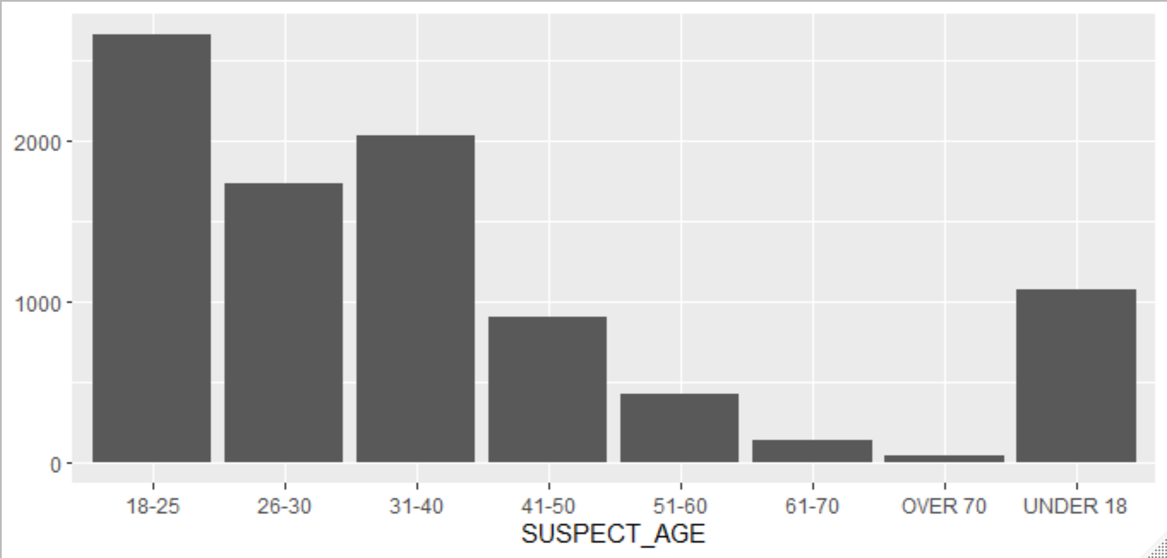
Why we care about factors

Slide 47
Working with factors
Factors are a useful data structure, particularly for modeling and visualizations, because they control the order of levels
Working with factors in Base R can be frustrating because of syntax inconsistencies and a handful of missing tools
The forcats package allows you to modify factors with minimal pain

Slide 48
How R represents and stores factors
Factors: R’s representation of categorical data. Consists of:
A set of discrete values
An ordered set of valid levels
(eyes <- base::factor(x = c("blue", "green", "green"),
levels = c("blue", "brown", "green")))
Stored as an integer vector with a levels attribute
unclass(eyes)
[1] 1 3 3
attr(,"levels")
[1] "blue" "brown" "green"

Slide 49
forcats functions and common tasks
All forcats functions start with fct_
fct_relevel()
fct_recode()
fct_collapse()
fct_unique()
Common tasks we’re covering
Reorder levels
Recode levels
Collapse levels
Temporarily reorder levels
Reorder levels based on other variable(s)
… and more!

Slide 50
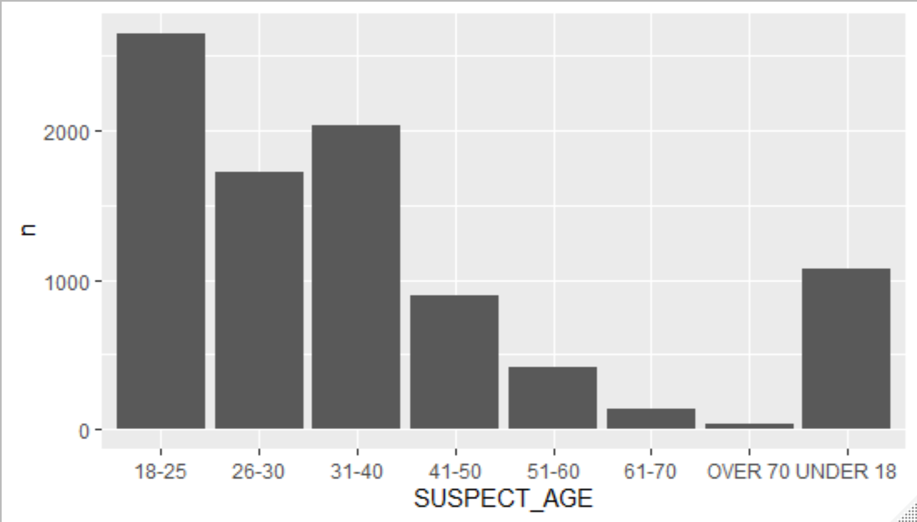
Graphing without reordering factor levels
# create a new data set
age <- crime %>%
# filter suspect ages simply for readability
filter(SUSPECT_AGE != "UNKNOWN")
# notice how SUSPECT_AGE is a character variable
age %>% count(SUSPECT_AGE)
# A tibble: 8 x 2
SUSPECT_AGE n
<chr> <int>
1 18-25 2652
2 26-30 1724
3 31-40 2031
4 41-50 899
5 51-60 418
6 61-70 137
7 OVER 70 33
8 UNDER 18 1068

Slide 51
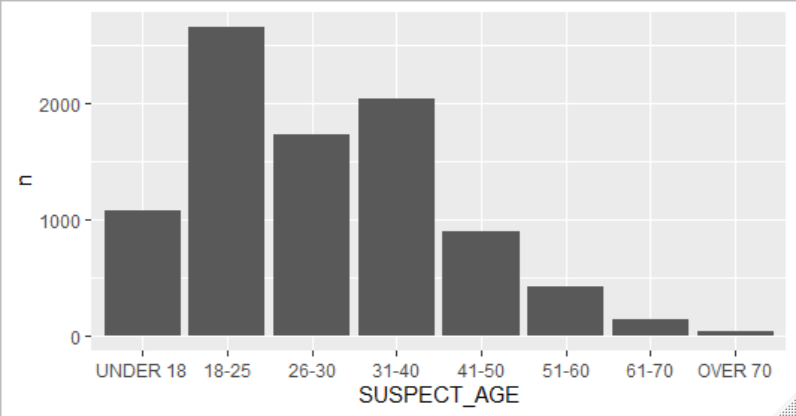
Reorder levels with fct_relevel()
age_releveled <- age %>%
# fct_relevel() converts characters to factors
mutate(SUSPECT_AGE = fct_relevel(SUSPECT_AGE,
"UNDER 18",
"18-25",
"26-30",
"31-40",
"41-50",
"51-60",
"61-70",
"OVER 70"))
# SUSPECT_AGE is now a factor that we reordered!
age_releveled %>% count(SUSPECT_AGE)
# A tibble: 8 x 2
SUSPECT_AGE n
<fct> <int>
1 UNDER 18 1068
2 18-25 2652
3 26-30 1724
4 31-40 2031
5 41-50 899
6 51-60 418
7 61-70 137
8 OVER 70 33

Slide 52
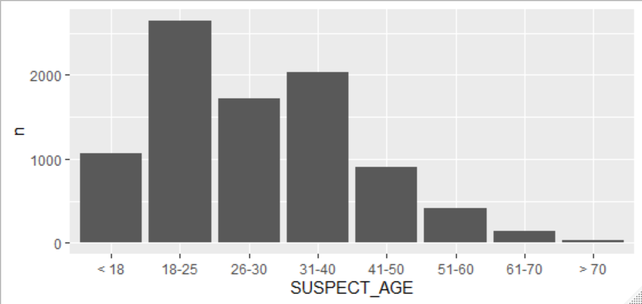
Recode levels with fct_recode()
age_recoded <- age_releveled %>%
mutate(
SUSPECT_AGE = fct_recode(
SUSPECT_AGE,
# new = old
"< 18" = "UNDER 18",
"> 70" = "OVER 70"
)
)

Slide 53
Your turn!
Using our crimes data set, fill in the blanks (in the provided R script) to:
Create a variable called suspect_generation where the suspect’s age
From zero to 18 is “student”
From 18 to 60 is “working_adult”
60+ is “retired”
Reorder the suspect_generation variable in student/working_adult/retired order
Make a bar chart to show the distribution of the suspect_generation variable

Slide 54
SOLUTION
crime %>%
mutate(suspect_generation = case_when(SUSPECT_AGE == "UNDER 18" ~ "student",
SUSPECT_AGE == "OVER 70" ~ "retired",
is.na(SUSPECT_AGE) ~ NA_character_,
TRUE ~ "working_adult"),
suspect_generation = fct_relevel(suspect_generation,
"student", "working_adult", "retired")) %>%
ggplot(aes(x = suspect_generation)) +
geom_bar() +
labs(x = "Suspect Generation",
y = "Frequency") +
coord_flip() +
theme_minimal()

Slide 55
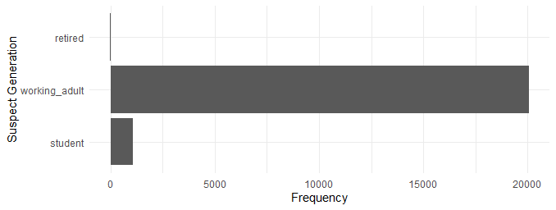
solution

Slide 56
COLLAPSE FACTORS with fct_collapse()
There are 7(8 if counting NA) distinct values for DAYOFWEEK…
…but we can collapse these into 2(3 if counting NA) levels.
crime %>%
distinct(DAYOFWEEK)
# A tibble: 8 x 1
DAYOFWEEK
<chr>
1 SATURDAY
2 THURSDAY
3 TUESDAY
4 WEDNESDAY
5 SUNDAY
6 FRIDAY
7 MONDAY
8 NA
day <- crime %>%
mutate(
type_of_day = fct_collapse(
DAYOFWEEK,
weekday = c("MONDAY", "TUESDAY",
"WEDNESDAY", "THURSDAY",
"FRIDAY"),
weekend = c("SATURDAY", "SUNDAY")
),
# give missing values an explicit factor level
# ensure they appear in summaries and on plots
type_of_day = fct_explicit_na(type_of_day)
)

Slide 57
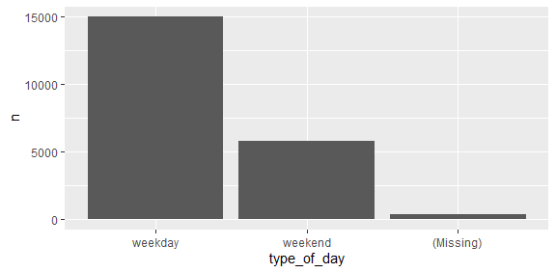
COLLAPSE FACTORS with fct_collapse()
Our new graph reflects the changed levels!
day %>% count(type_of_day)
# A tibble: 3 x 2
type_of_day n
<fct> <int>
1 weekday 14982
2 weekend 5808
3 (Missing) 363

Slide 58
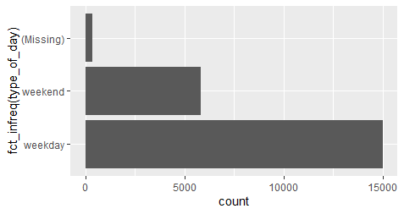
TEMPORARILY REORDER FACTORS
Place certain forcats functions inside ggplot() calls to temporarily reorder factors without permanently altering levels.
fct_infreq() orders by frequency
crime %>%
distinct(DAYOFWEEK)
# A tibble: 8 x 1
DAYOFWEEK
<chr>
1 SATURDAY
2 THURSDAY
3 TUESDAY
4 WEDNESDAY
5 SUNDAY
6 FRIDAY
7 MONDAY
8 NA
day %>%
ggplot(aes(x = fct_infreq(type_of_day))) +
geom_bar() +
coord_flip()

Slide 59
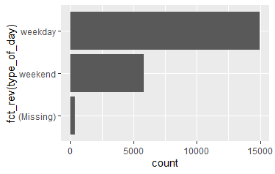
TEMPORARILY REORDER FACTORS
Place certain forcats functions inside ggplot() calls to temporarily reorder factors without permanently altering levels.
fct_rev() reverses the order of factor levels
crime %>%
distinct(DAYOFWEEK)
# A tibble: 8 x 1
DAYOFWEEK
<chr>
1 SATURDAY
2 THURSDAY
3 TUESDAY
4 WEDNESDAY
5 SUNDAY
6 FRIDAY
7 MONDAY
8 NA
day %>%
ggplot(aes(x = fct_rev(type_of_day))) +
geom_bar() +
coord_flip()

Slide 60
Your turn!
Using our crimes data set and the VICTIM_GENDER variable, fill in the blanks (in the provided R script) to:
Give missing values an explicit factor level so they appear in summaries and on plots.
Collapse factor levels into “female”, “male”, “non_person”, and “not_reported”.
Count the number of victim per reported gender.
Use fct_reorder() to make a plot (read documentation!).

Slide 61
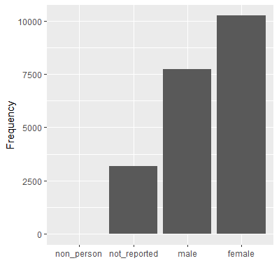
SOLUTION
crime %>%
transmute(
VICTIM_GENDER = fct_explicit_na(VICTIM_GENDER),
VICTIM_GENDER = fct_collapse(
VICTIM_GENDER,
female = c("FEMALE", "F - FEMALE"),
male = c("MALE", "M - MALE"),
non_person = "NON-PERSON (BUSINESS",
not_reported = c("(Missing)", "UNKNOWN")
)
) %>%
count(VICTIM_GENDER) %>%
ggplot(aes(x = fct_reorder(VICTIM_GENDER, n),
y = n)) +
geom_col() +
labs(x = NULL,
y = "Frequency")

Slide 62
FOR MORE INFORMATION
https://forcats.tidyverse.org/

Slide 63

03/ DATES AND TIMES

Slide 64
lubridate functions and common tasks
Sorry, but lubridate functions don’t have a common prefix.
Common tasks we’re covering
Parse strings into dates/times
Extract components of dates
Adding/subtracting periods and durations
… and more (that we’re not covering)

Slide 65
Creating date/time values and variables
Parse strings into dates and times (letters dictate order) with functions like these:
ymd()
dmy_h()
ydm_hm()
mdy_hms()
… and many more functions!
lubridate handles many string formats!
# year, month, day
ymd("2019-08-20")
[1] "2019-08-20“
# some parsing functions allow unquoted numbers
ymd(20190820)
[1] "2019-08-20”
# day, month, year, hour
dmy_h("20/08/2019 14")
[1] "2019-08-20 14:00:00 UTC“
# year, day, month, hour, minute
ydm_hm("2019/20/08 07:20")
[1] "2019-08-20 07:20:00 UTC“
# month, day, year, hour, minute, second
mdy_hms("August 20, 2019 10:12:32")
[1] "2019-08-20 10:12:32 UTC"

Slide 66
Extract components of dates
Boolean components
Numeric components
# check if datetime in am
am("2019-08-20 17:00:00")
[1] FALSE
# check for daylight savings time
dst(now())
[1] FALSE
# check for leap year (requires date input)
x <- as_date("2019-08-20")
leap_year(x)
[1] FALSE
# extract year
year("2019-08-20")
[1] 2019
# extract full weekday name
wday("2019-08-20", label = TRUE, abbr = TRUE)
[1] Tue
Levels: Sun < Mon < Tue < Wed < Thu < Fri < Sat
# extract hour
hour("2019-08-20 02:42")
[1] 2
# extract calendar year quarter
quarter("2019-08-20")
[1] 3

Slide 67
Your turn!
The Cincinnati Police Department has a question:
Do certain months have more victims than other months?
Using our crimes data set, fill in the blanks and asterisks (in the provided R script) and read the comments to answer this question.

Slide 68
SOLUTION
crime %>%
# convert the DATE_REPORTED variable into
# a datetime variable showing the month, day, year, hour, minute
mutate(DATE_REPORTED = mdy_hm(DATE_REPORTED),
# create a month variable by extracting the month
# from the DATE_REPORTED variable
month = month(DATE_REPORTED)) %>%
# what should you group by?
group_by(month) %>%
# we need a total_victims statistic
summarize(total_victims = sum(TOTALNUMBERVICTIMS, na.rm = TRUE)) %>%
# create a line graph to show change over time
ggplot(aes(x = month, y = total_victims)) +
geom_line()

Slide 69
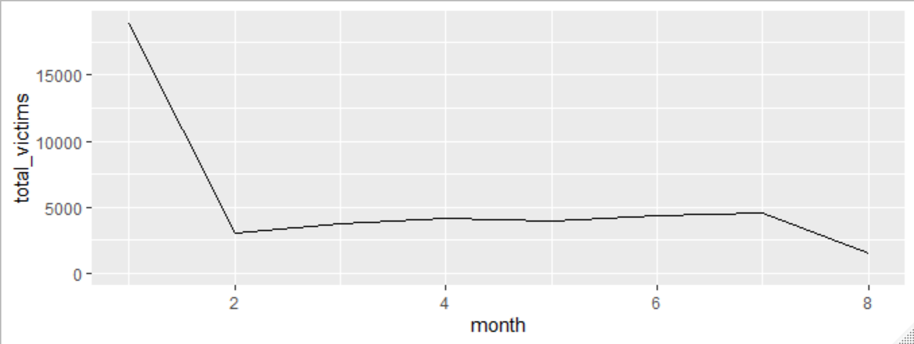
SOLUTION

Slide 70

DURATIONS
How old is Surge? R stores this calculation as a difftime object with the attribute naming the units.
lubridate can store this information as a duration which always uses seconds, avoiding ambiguity with different time units.
# Thanks Wikipedia!
(surge_age <- today() - ymd(19970727))
Time difference of 8148 days
as.duration(surge_age)
[1] "703987200s (~22.31 years)"

Slide 71
Working with DURATIONS
Function to create durations
(they all begin with d)
Add and multiply durations
dseconds(20)
[1] "20s"
dminutes(c(11, 525600))
[1] "660s (~11 minutes)"
[2] "31536000s (~52.14 weeks)"
dweeks(1:4)
[1] "604800s (~1 weeks)" "1209600s (~2 weeks)"
[3] "1814400s (~3 weeks)" "2419200s (~4 weeks)"
3 * dhours(1)
[1] "10800s (~3 hours)"
dyears(2) + dweeks(3) + dhours(1)
[1] "64890000s (~2.06 years)"
Add and subtract durations involving days
today() - dyears(2)
[1] "2020-11-2"
… and many more functions!

Slide 72

Where durations fail us
Leap years
(five_somewhere <- ymd_hms("2016-01-01 17:00:00"))
[1] "2016-01-01 17:00:00 UTC"
five_somewhere + dyears(1)
[1] "2016-12-31 17:00:00 UTC"
Daylight saving time
(hashtag_fall <- ymd_hms("2019-11-02 15:00:00", tz = "America/New_York"))
[1] "2019-11-02 15:00:00 EDT"
hashtag_fall + ddays(1)
[1] "2019-11-03 14:00:00 EST"

Slide 73
Periods to save the day
lubridate also uses periods—time spans that are not fixed lengths but work with “human” times
hashtag_fall
[1] "2019-11-02 15:00:00 EDT"
hashtag_fall + days(1)
[1] "2019-11-03 15:00:00 EST"
Examples of creating periods (no common prefix)
seconds(20)
[1] "20S"
minutes(c(11, 525600))
[1] "11M 0S" "525600M 0S"
weeks(1:4)
[1] "7d 0H 0M 0S" "14d 0H 0M 0S" "21d 0H 0M 0S" "28d 0H 0M 0S"

Slide 74
Adding and multiplying periods
Add and multiply periods
Add periods to dates
4 * (years(2) + minutes(3))
[1] "8y 0m 0d 0H 12M 0S"
days(6) + minutes(600) + seconds(3)
[1] "6d 0H 600M 3S"
# leap year
five_somewhere + dyears(1)
[1] "2016-12-31 17:00:00 UTC"
five_somewhere + years(1)
[1] "2017-01-01 17:00:00 UTC"
# daylight saving time
hashtag_fall + ddays(1)
[1] "2019-11-03 14:00:00 EST"
hashtag_fall + days(1)
[1] "2019-11-03 15:00:00 EST"

Slide 75
FOR MORE INFORMATION
Other tasks with lubridate:
Accounting for and changing time zones
Determining if two time intervals overlap
https://lubridate.tidyverse.org/

Slide 76


